Slide 1
COMP 3006 – Software Engineering
Stock Monitoring System
404 NOT FOUND
12210102 MAK KIT TIN
15208249 LEUNG KAI HIN
13205633 CHAN WING SUN
13207296 YEUNG MAN KIT
Notes:
This template can be used as a starter file for a photo album.

Slide 2
Stock monitoring system
Introduction

Slide 3
What is Stock Monitoring System
Stock Monitoring System aims to serve individual investors by providing real-time stock information with their watch lists. It is also a platform for users with different investment habits to track their target stocks and be notified when their tracking stocks reach their custom target price ranges.
Stock price notification function would display the real-time stock market situation and changes by alerting the users with the notification function via the program itself automatically. These notification messages could provide useful and instant helps to users so they would be aware of the changes of their target stocks during the daily life. Moreover, personal watch lists and profit calculator are also delivered to users which allow them to manage their target stocks in the organized and clear interface.

Slide 4
Why do we need to develop this system
Problems of software in the market:
Information not up to date
Data not sync
Not user friendly
Poor security
Price issue

Slide 5
Difficulties of the system
API for stock information
Auto-refresh 20 stocks at the same time without system failure
System is developed by using python
Time issue

Slide 6
How to overcome the difficulties
Using free API
Multi-threading/processing technology
Using free GUI-framework to develop the program
Using existing libraries

Slide 7
Functions of the Program
User Management System
Register
Login*
Logout*
Setting
News Display System
Display news related to HK stock market*
Stock Searching Engine
Search stock real-time information*

Slide 8
Functions of the Program
Stock Monitoring System
Stock price tracking*
Notification System
Notification for custom stock conditions.
Administration System
Modify user information
Member authorization
System statistics

Slide 9
Stock monitoring system
System Overview

Slide 10
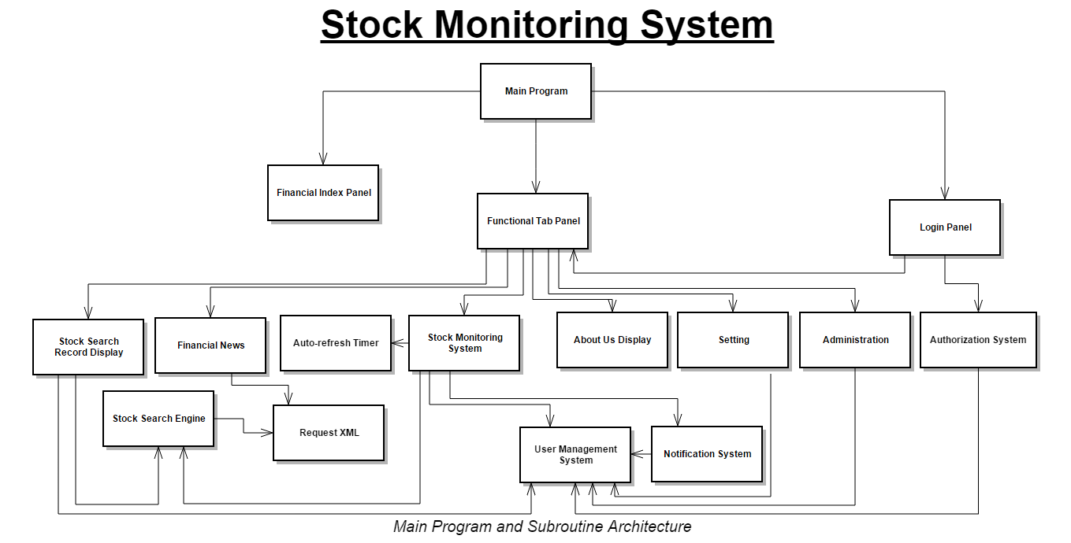
Notes:
System Design

Slide 11
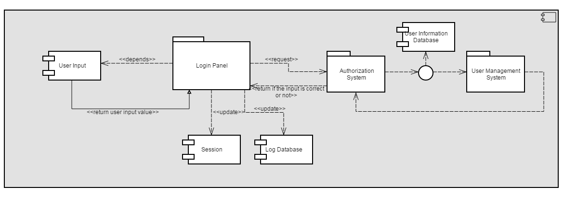
Notes:
Login Process – Component Design

Slide 12
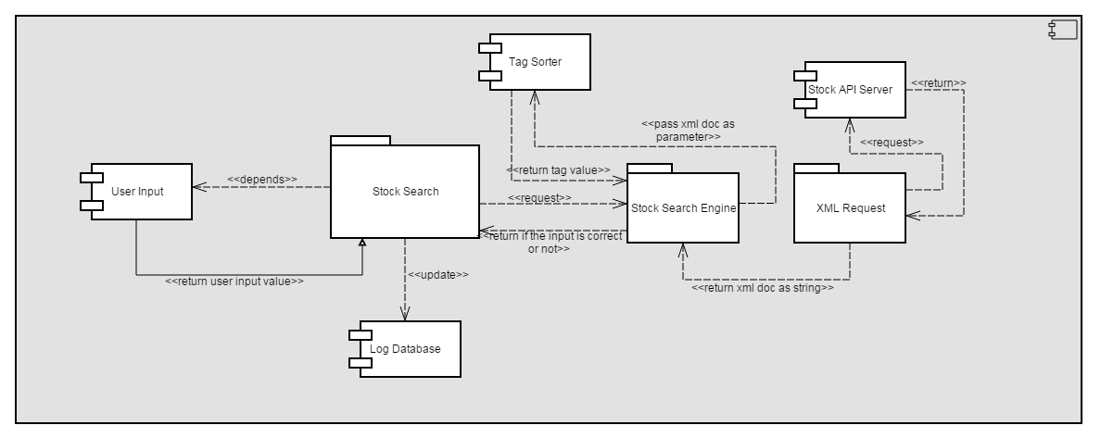
Notes:
Stock Search Engine– Component Design

Slide 13
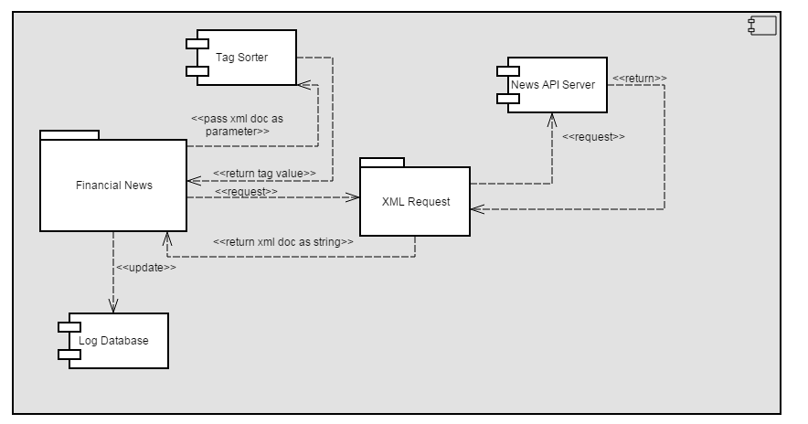
Notes:
Financial News– Component Design

Slide 14
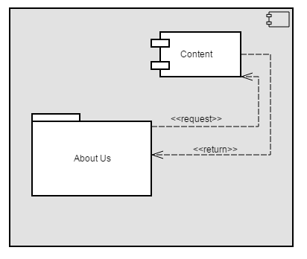
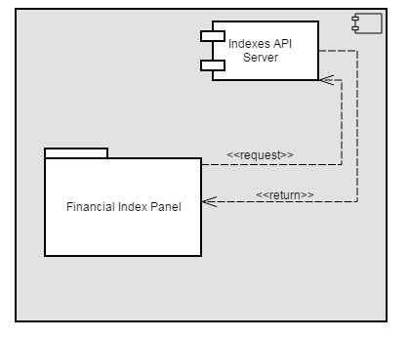
Notes:
About Us & Indexes– Component Design

Slide 15
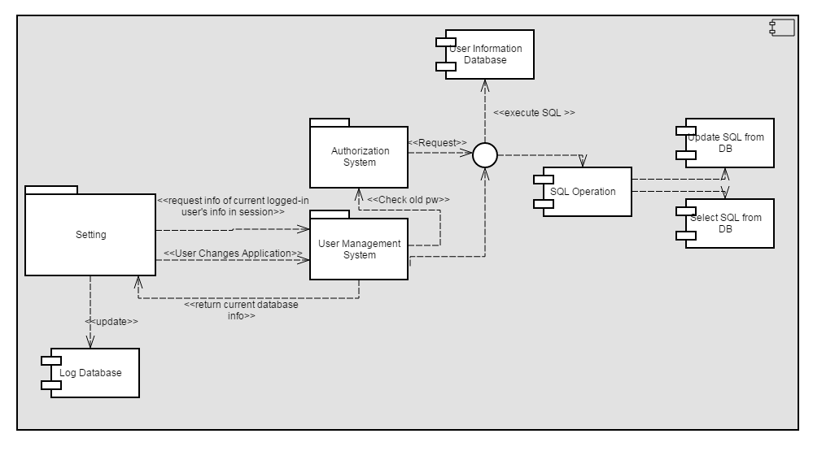
Notes:
Setting– Component Design

Slide 16
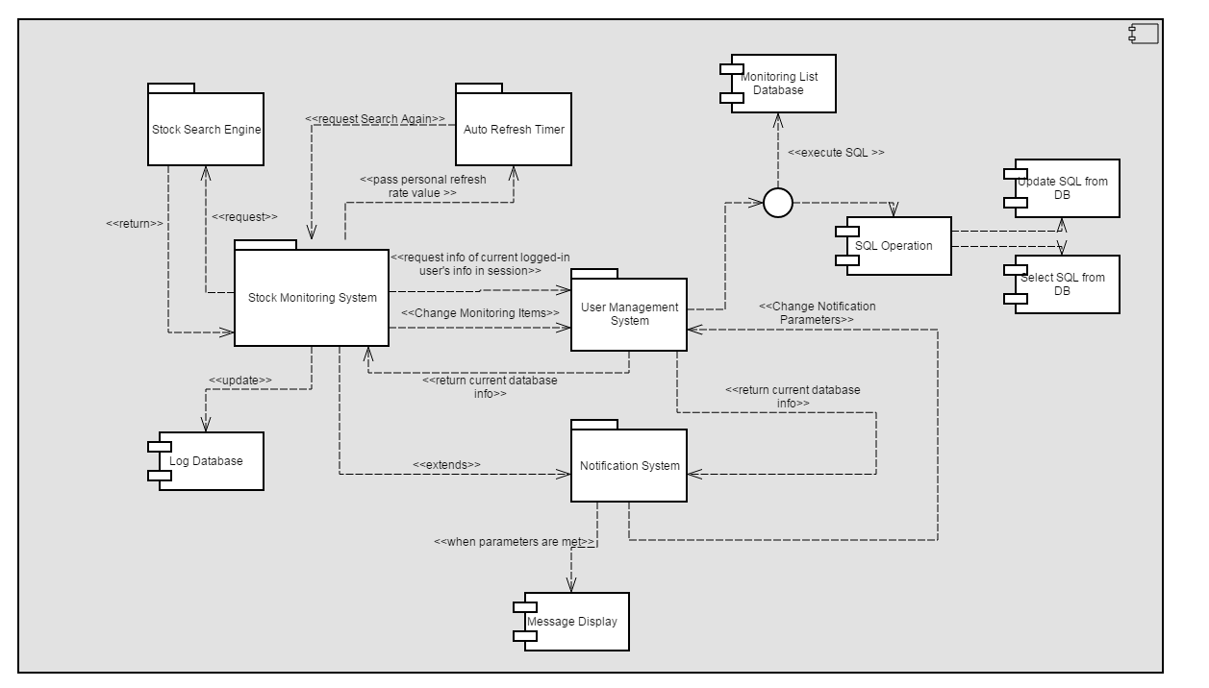
Notes:
Monitoring System + Notification– Component Design

Slide 17
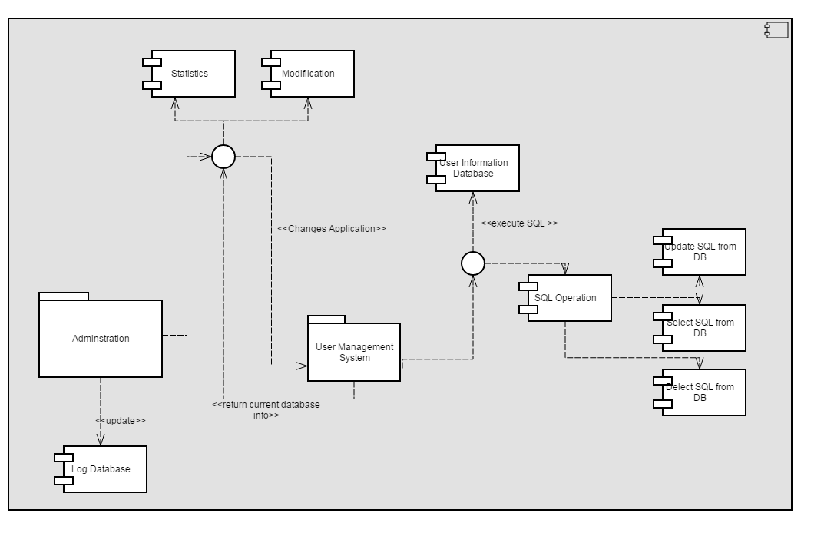
Notes:
Adminstration– Component Design

Slide 18
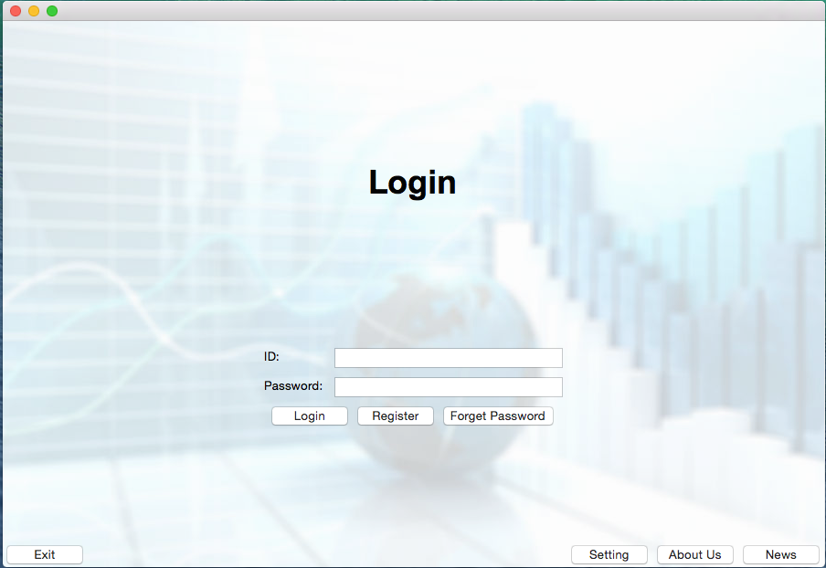
Notes:
UI – MemberMangagementSystem_HomePage

Slide 19
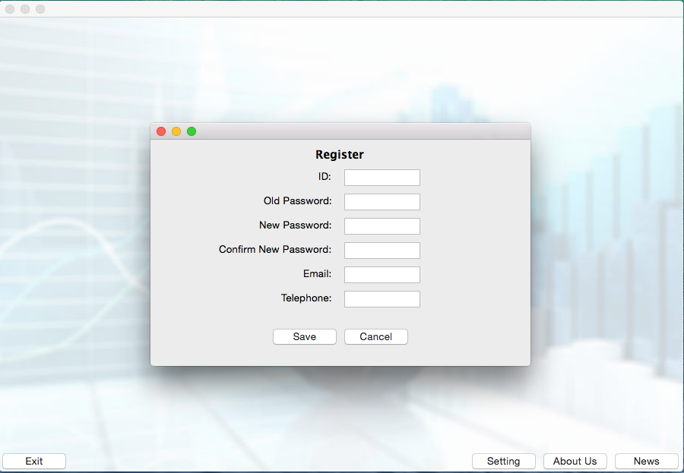
Notes:
UI - MemberMangagementSystem_Register

Slide 20
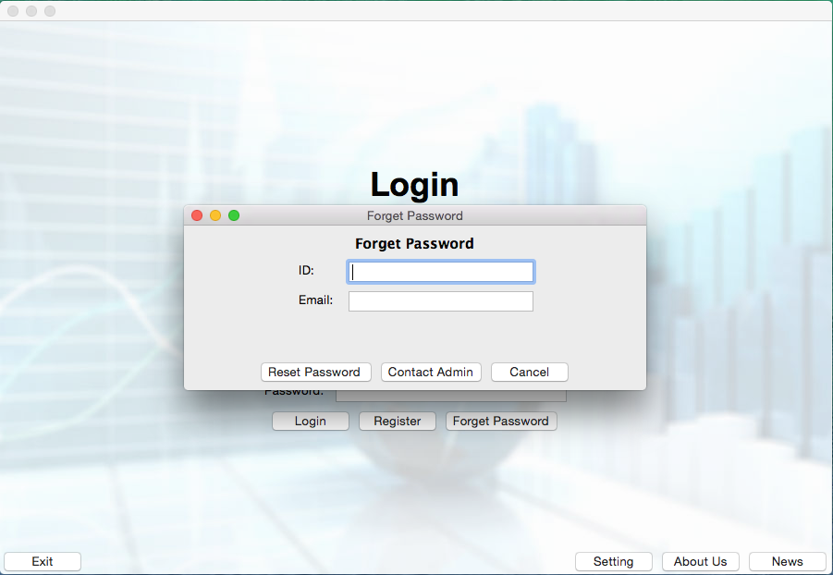
Notes:
UI – Forget PW

Slide 21
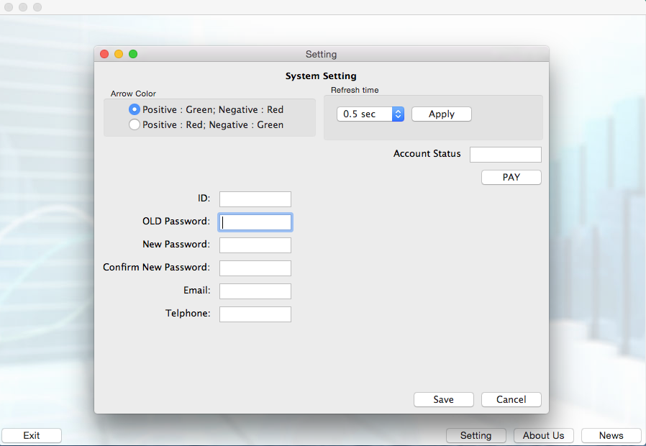
Notes:
UI - MemberMangagementSystem_Setting

Slide 22
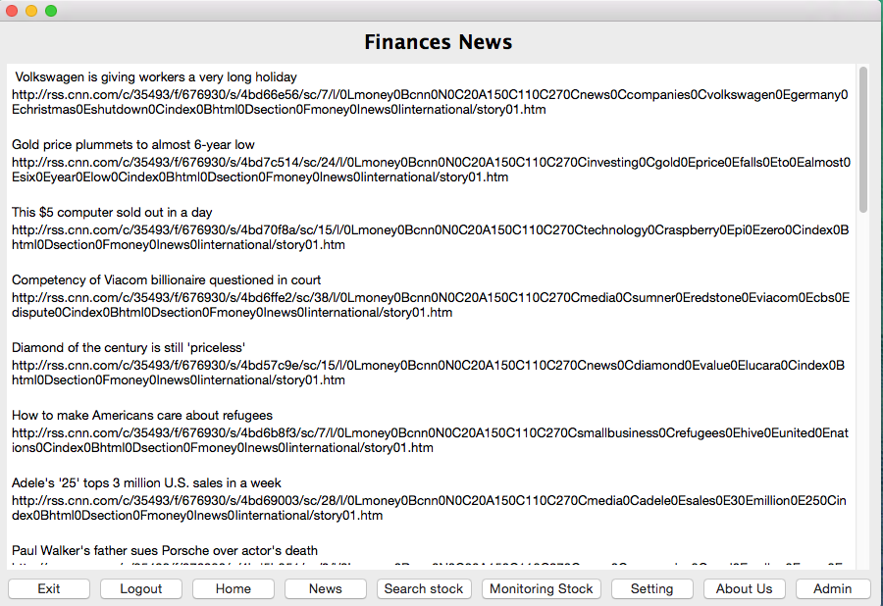
Notes:
UI - NewsDisplay

Slide 23
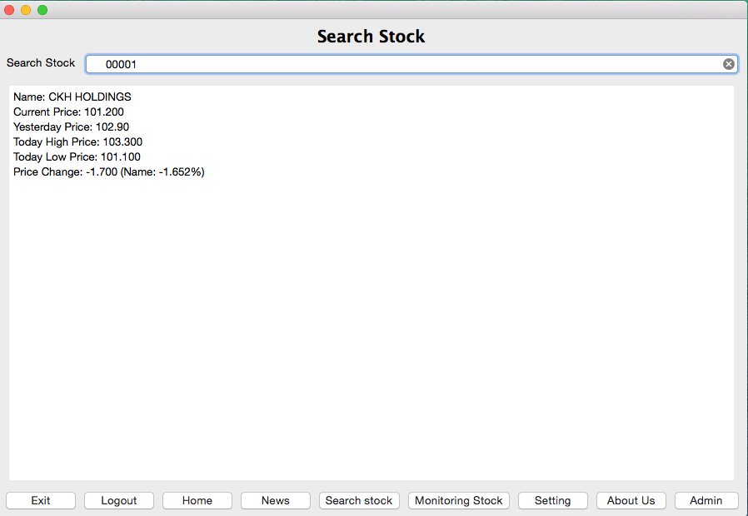
Notes:
UI - StockSearchEngine

Slide 24
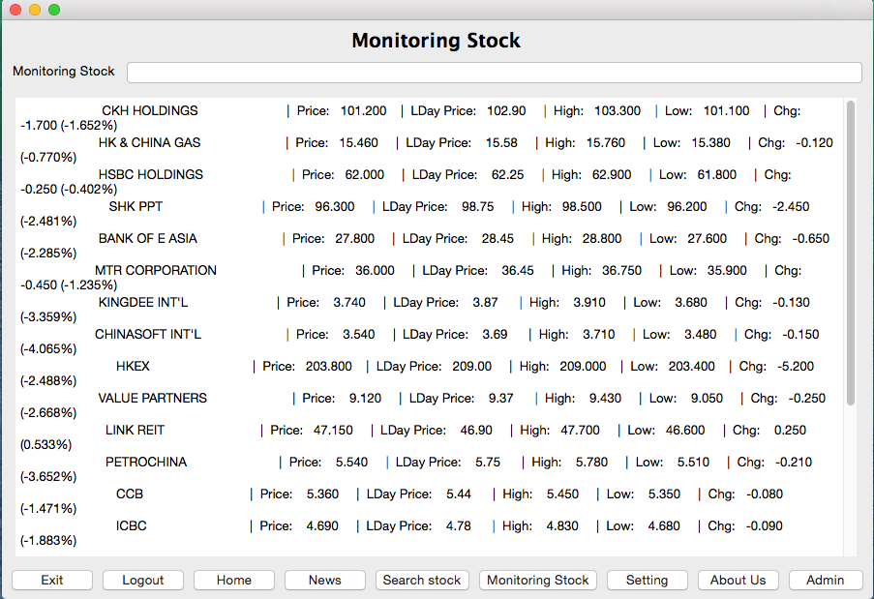
Notes:
UI - StockMonitoring

Slide 25
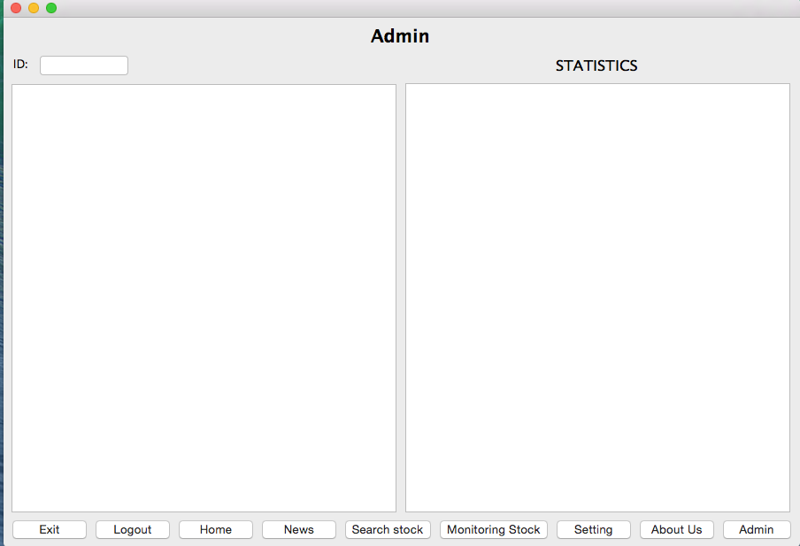
Notes:
UI - Admin

Slide 26
Notes:
UI – About Us

Slide 27
Stock monitoring system
Demonstration

Slide 28
Stock monitoring system
Future Development

Slide 29
Future development
GUI enhancement
Multi-processing/threading enhancement
Complete Functions Development
Multi-language platforms
System Security
Multi-Platform Compatible
Object Oriented Programming Enhancement

Slide 30

Q&A TIME

Slide 31
Thank You !

